Slide 1



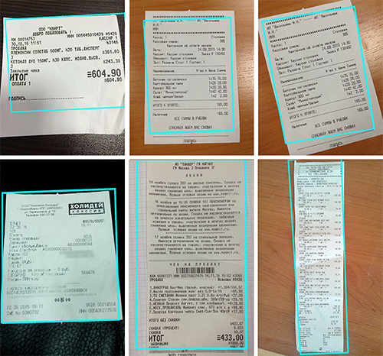
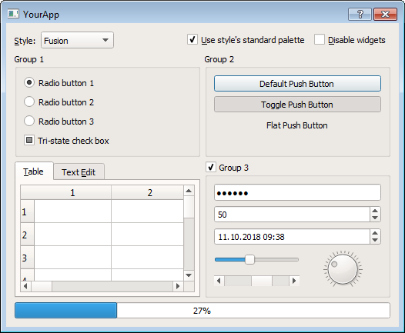
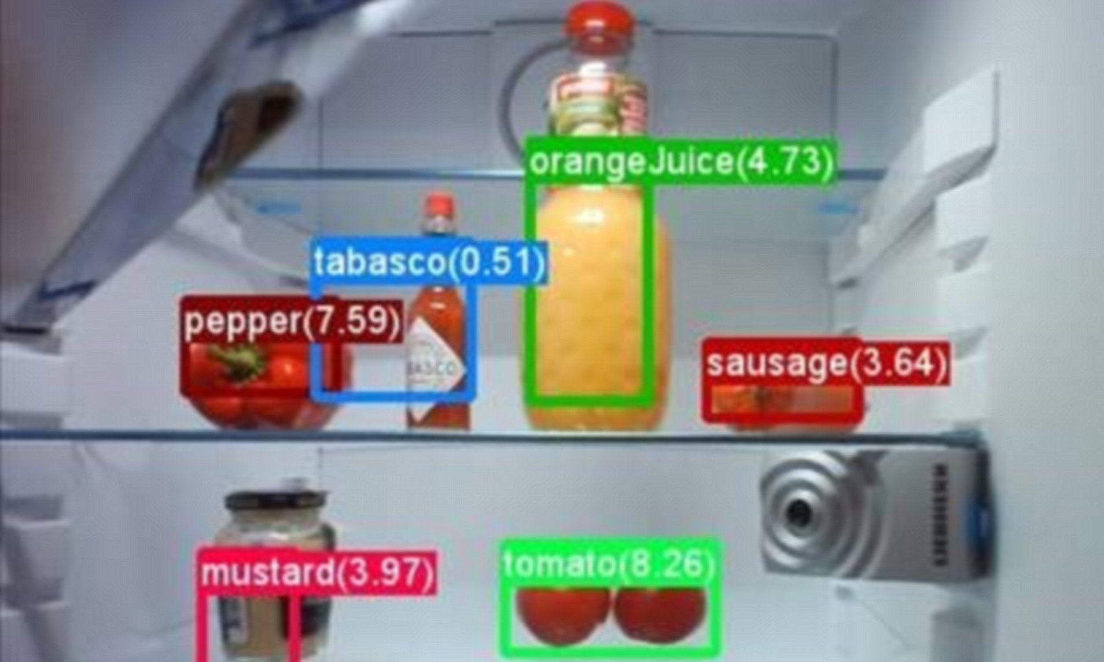

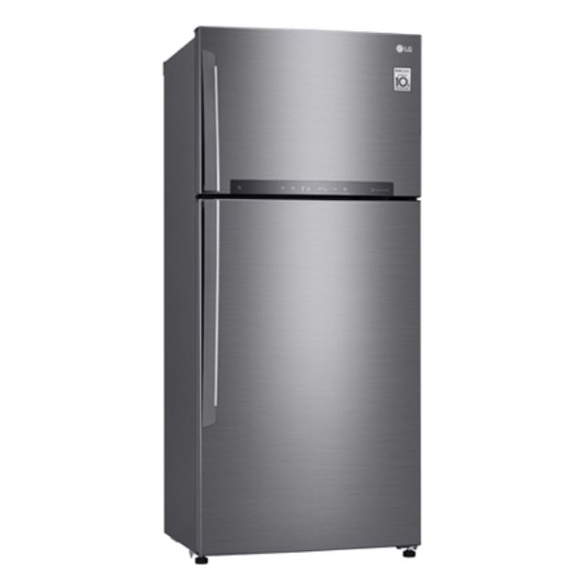

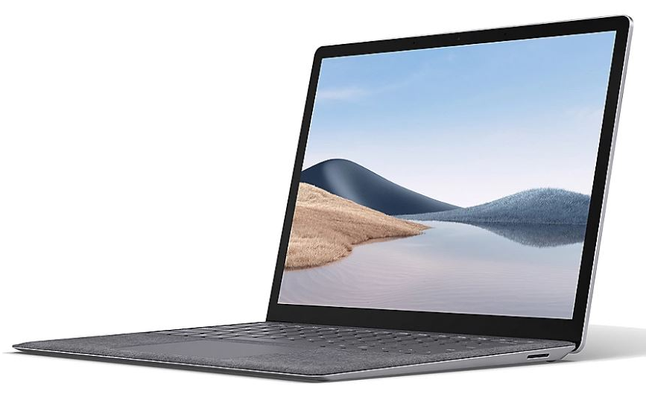
Object Storage
OCR Platform
Real-time Frame
Detected Receipt
Real-time Frame
Detected Object
Detected Receipt
Real-time Frame
Detected Object
Detected Receipt
Object Detection
in Fridge
Receipt Detection
Real-time check GUI

Slide 2
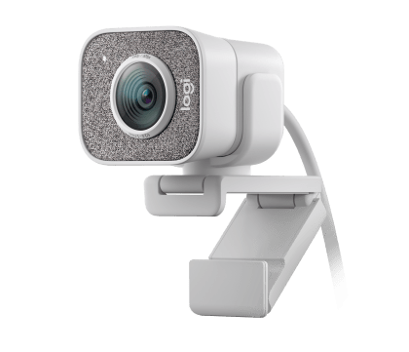
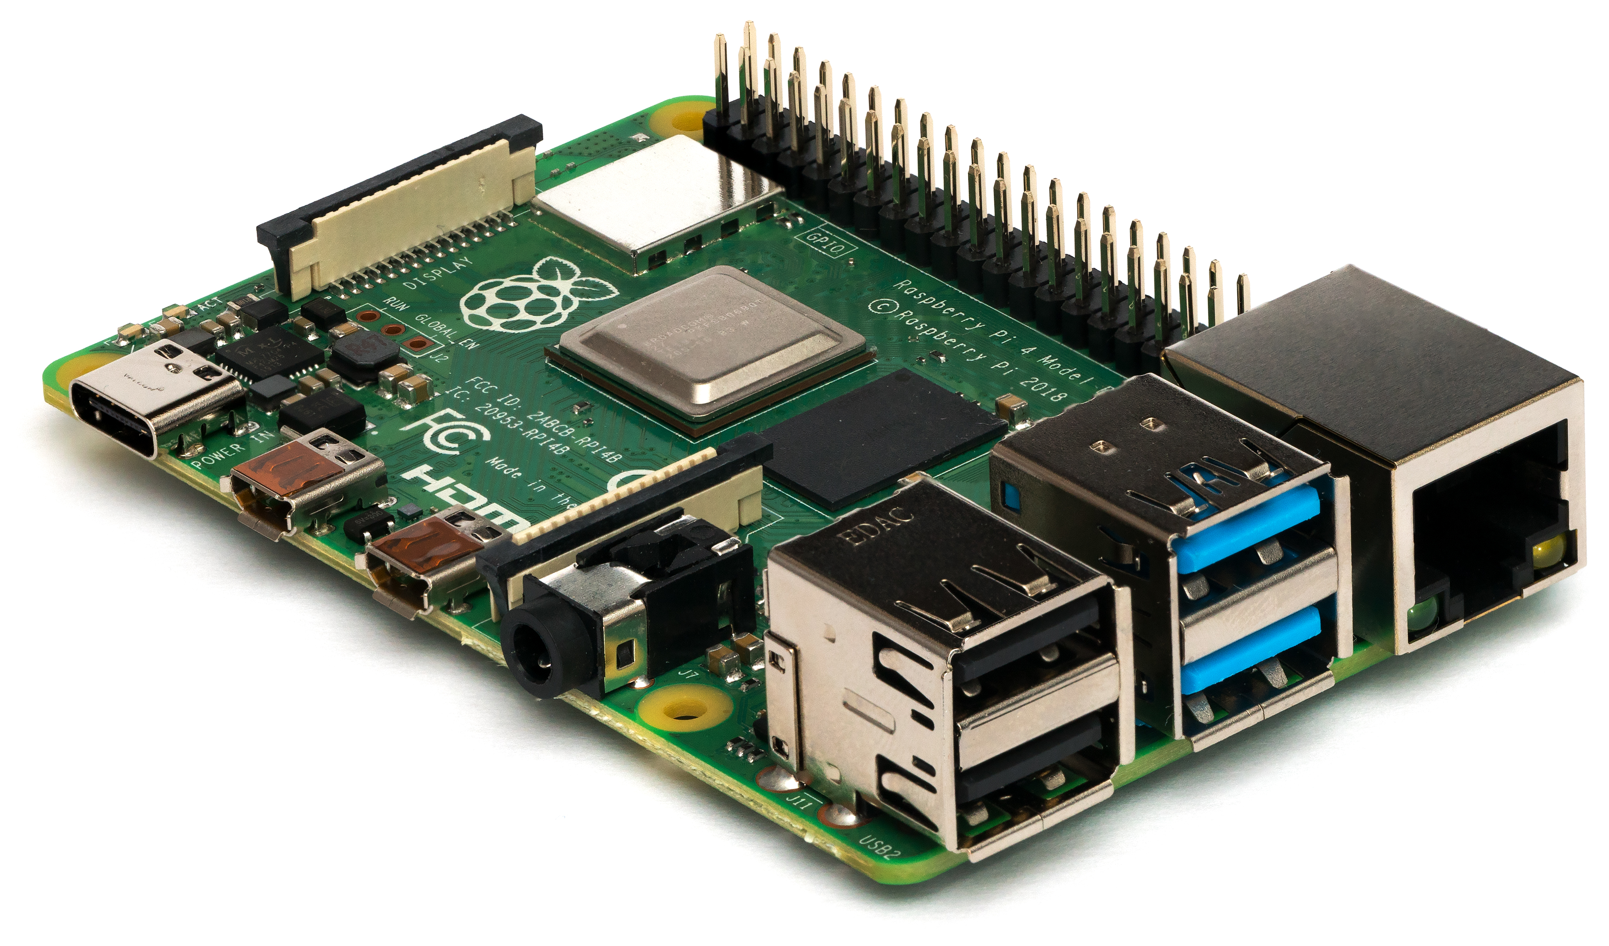
Pre-Processing
Detect Receipt
Image Binarization
Contour
Detection
Detected Receipt Image
Rectangle
Detection
Receipt Detection
OCR Receipt Text
Perspective
Transform
Data Parsing
Food Data Detection
Detect Food Object

Slide 3
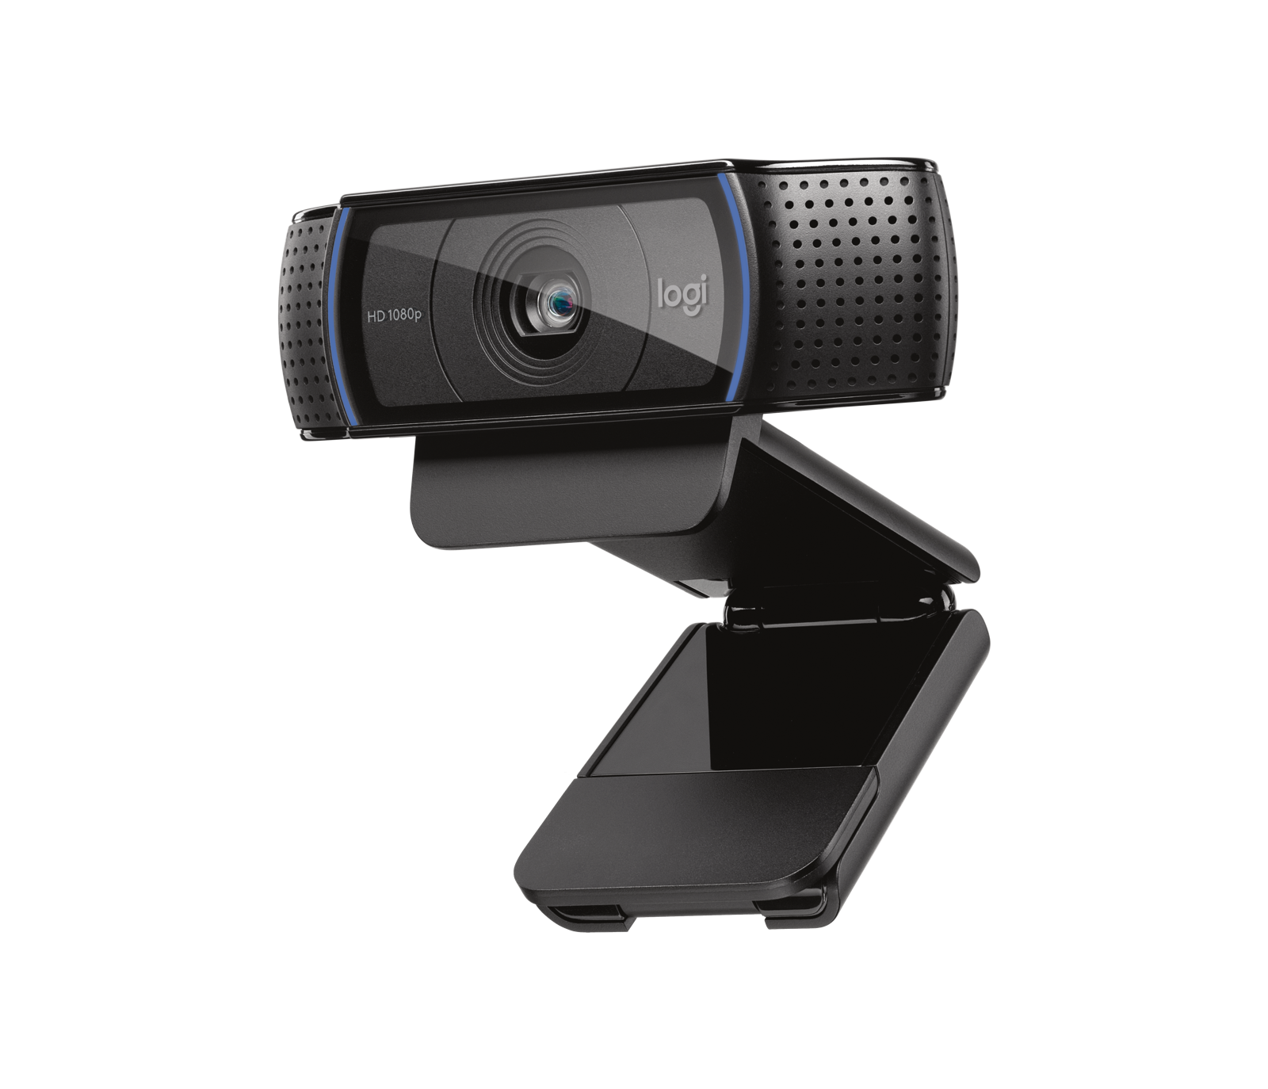
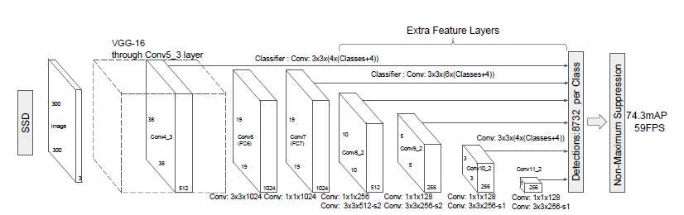
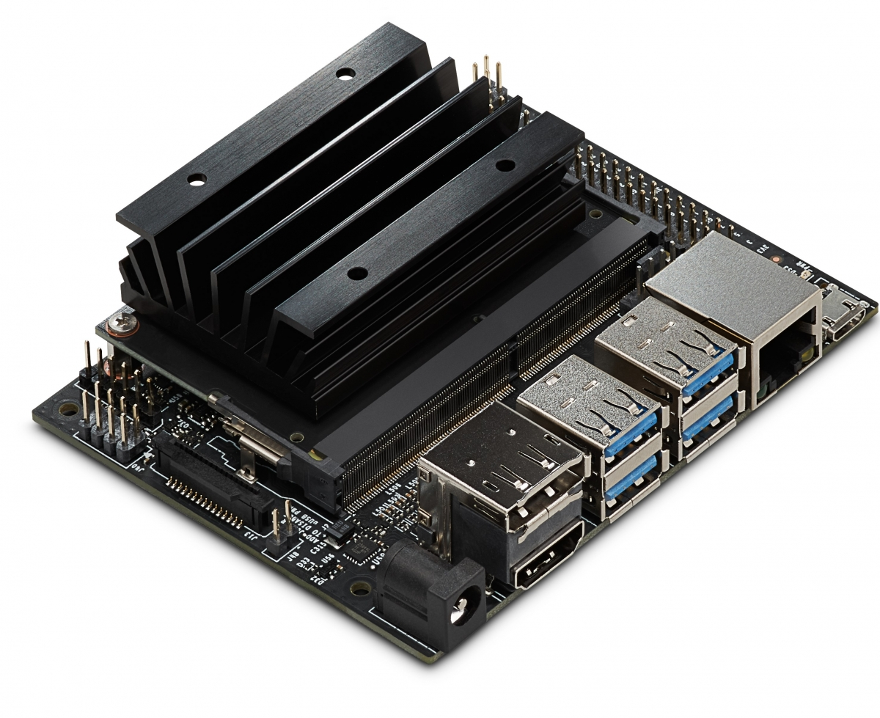

SSD-Mobilenet-V2
Object Detection in Fridge
TensorRT Obtimization
Detected Food Object
Food Object Detection

Slide 4

Real-time Frame
Detected Receipt
Detected Food Object from Receipt
Detected Food Label from Fridge
Real-time check GUI
Streaming
Real-time Frame
Convert
Food Label to Food name
Streaming
Real-time
text of food

